Slide 1
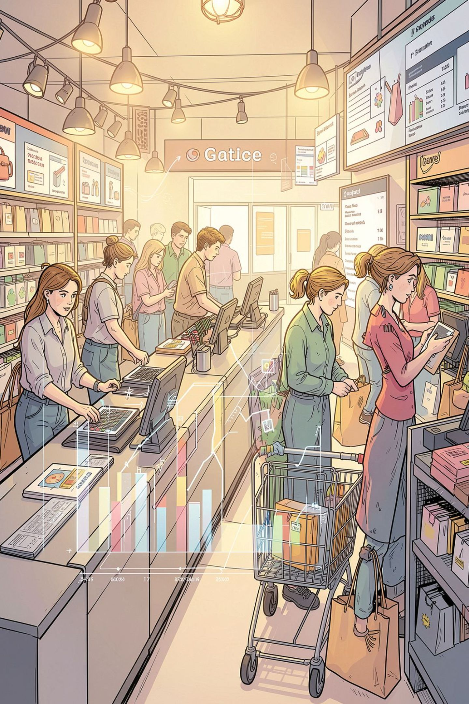
Customer Shopping Behavior Analysis
3,900 purchases • 18 columns • goal: uncover spending, segments, preferences

Slide 2

Dataset at a Glance
Rows & Columns
Key Features
3,900 rows • 18 columns
Demographics, purchase details, behavior, shipping
Missing Data
37 nulls in Review Rating

Slide 3

Python — Cleaning & Prep
01
Load & Explore
df.info(), .describe()
02
Impute Ratings
Median by product category
03
Standardize
Rename to snake_case
04
Feature Eng.
age_group, purchase_frequency_days

Slide 4
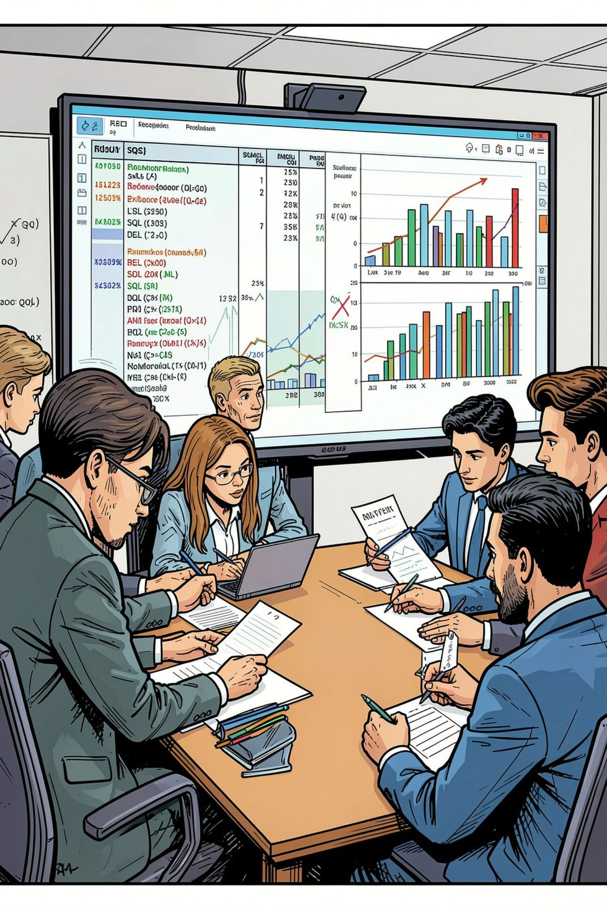
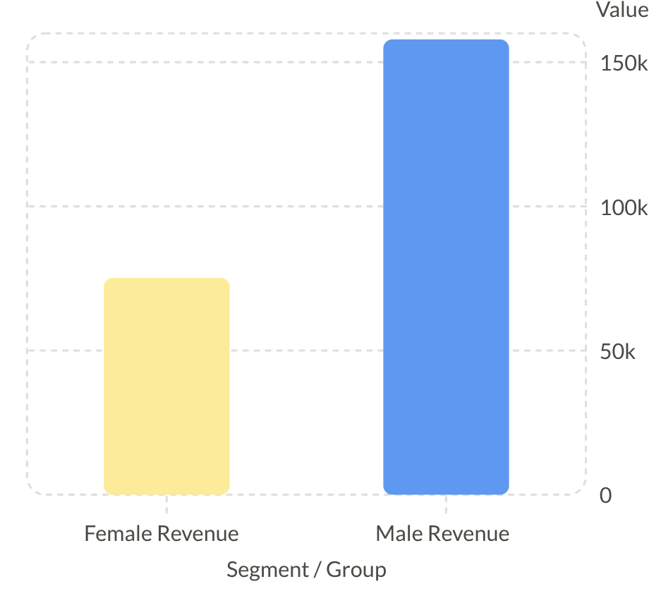
SQL Analysis — Revenue & Segments
Revenue by gender: Male > Female
Customer segments: Loyal 3,116 • Returning 701 • New 83

Slide 5




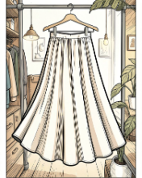
Top Products & Ratings
Gloves
Sandals
Boots
Hat
Avg rating 3.86
Avg rating 3.84
Avg rating 3.82
Avg rating 3.80
Skirt
Avg rating 3.78

Slide 6
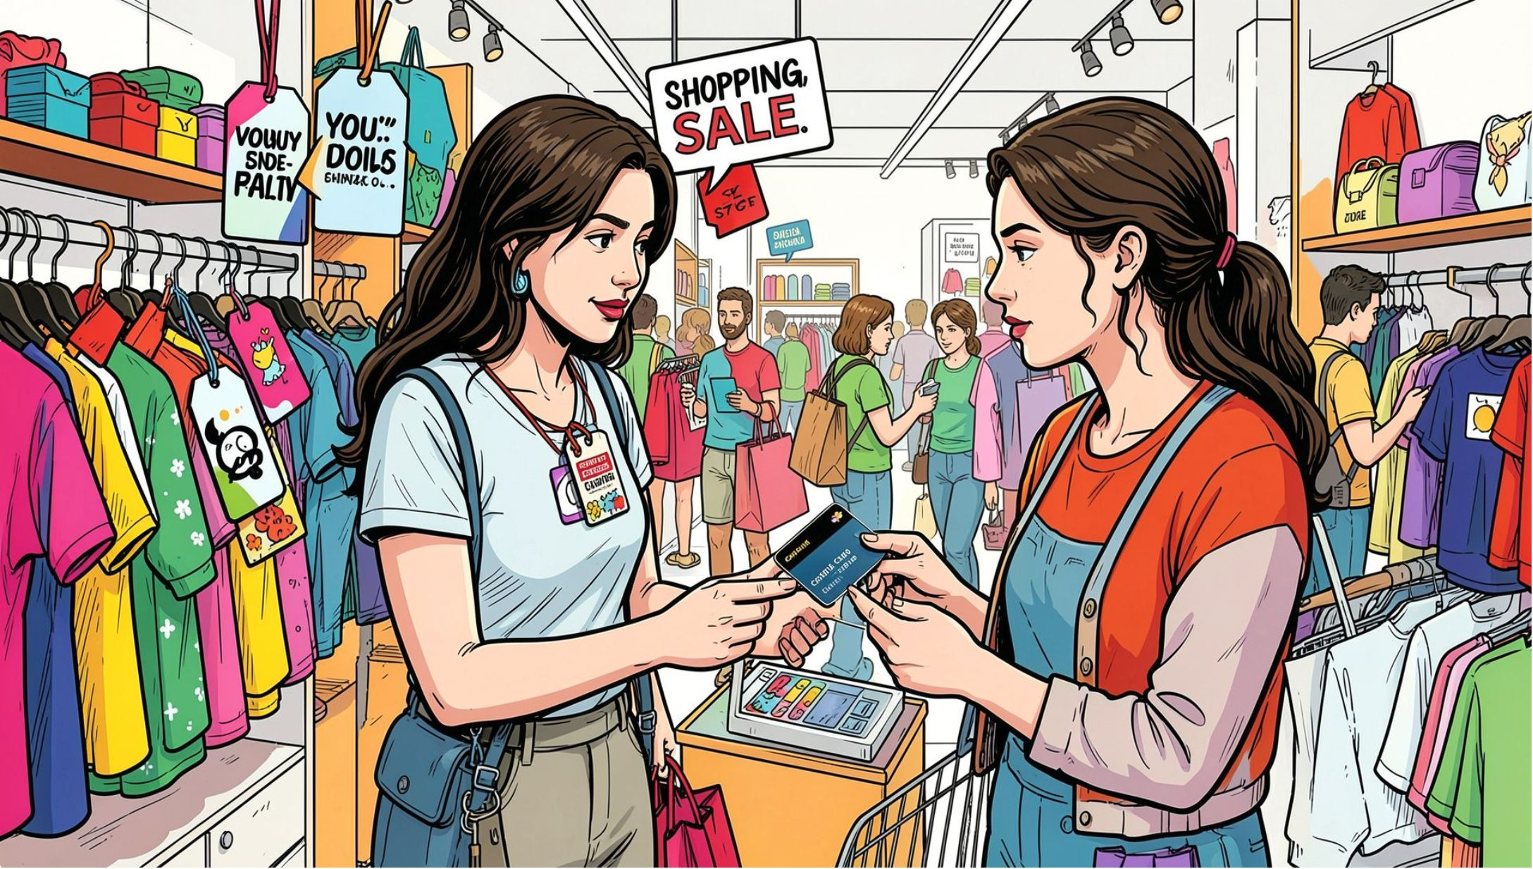


Discounts & High-Spenders
High-Spending Discount Users
839 rows — customers used discounts yet spent above average
Discount-Dependent Products
Top: Hat 50% • Sneakers 49.66% • Coat 49.07% • Sweater 48.17% • Pants 47.37%

Slide 7
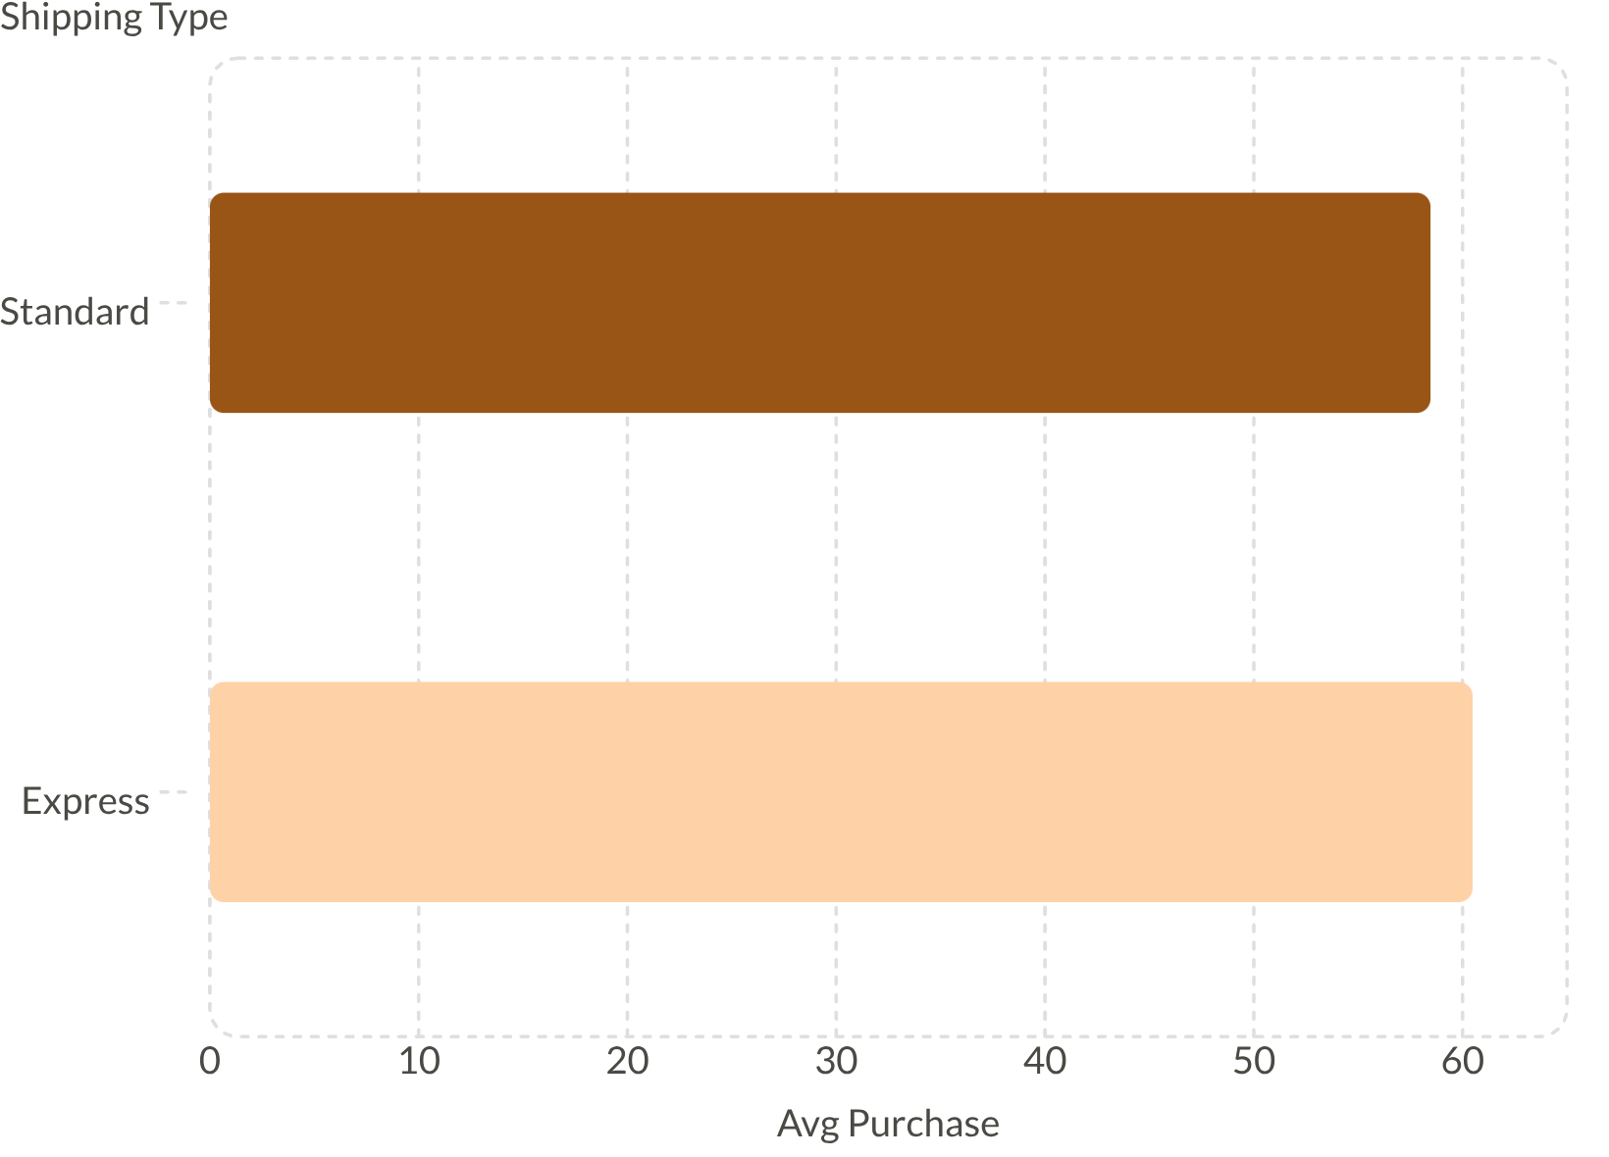

Shipping & Subscription Insights
Subscribers: 1,053 • avg spend $59.49 • total revenue $62,645
Non-subscribers: 2,847 • avg $59.87 • total $170,436
Subscribers contribute meaningful recurring revenue — opportunity to grow.

Slide 8
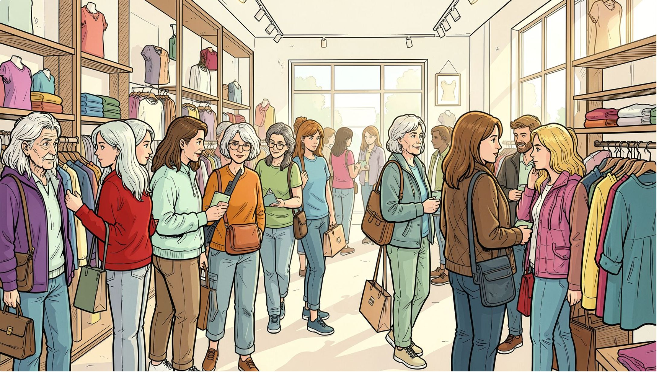
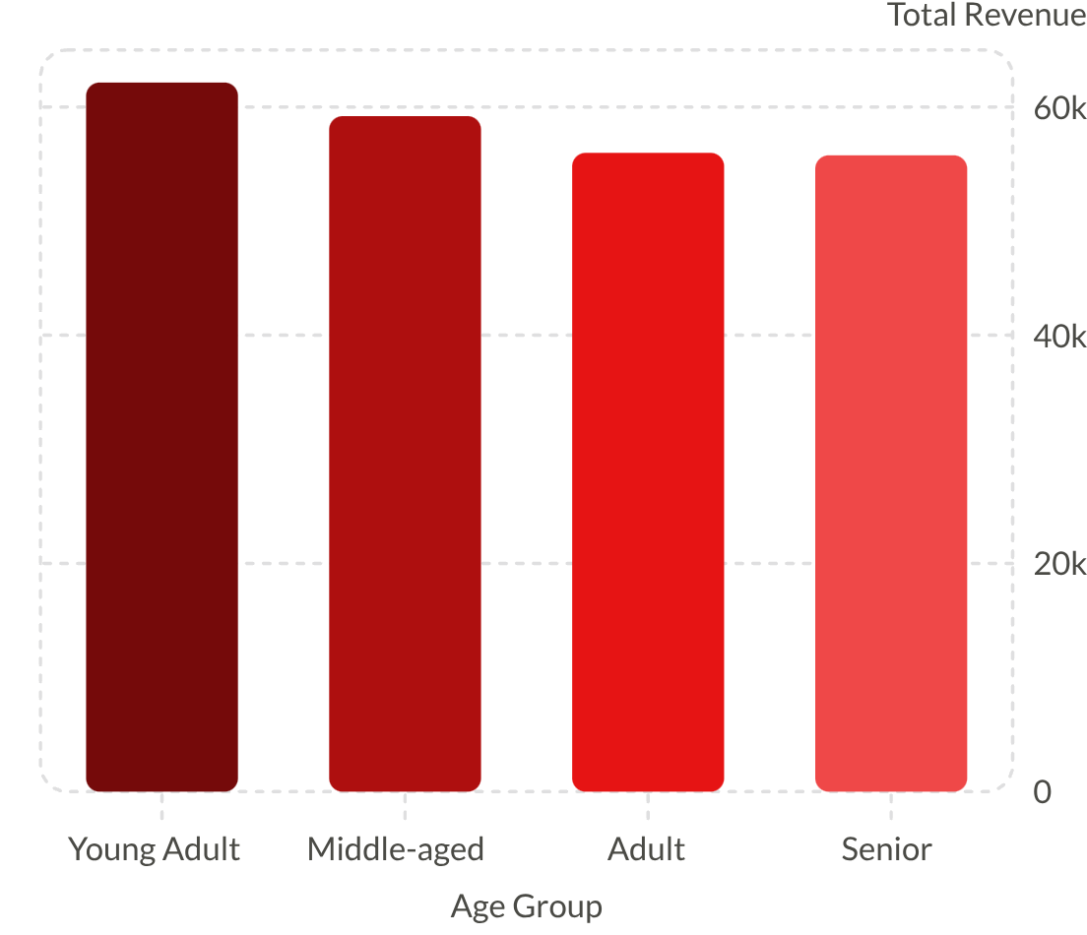
Age Groups & Revenue
Focus marketing on Young Adult & Middle-aged (largest revenue)

Slide 9
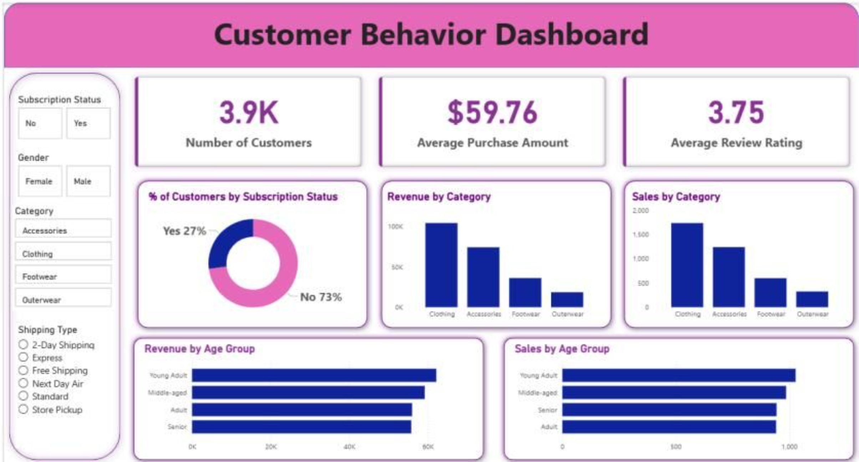



Power BI Dashboard
Key metrics showcased interactively
3.9K Customers
$59.76 Avg Purchase
3.75 Avg Rating

Slide 10





Business Recommendations
Boost Subscriptions
Promote exclusive subscriber benefits
Loyalty Programs
Reward repeat buyers to grow Loyal segment
Review Discount Policy
Balance sales lift with margin control
Product Positioning
Feature top-rated & best-selling items
Targeted Marketing
Focus on high-revenue age groups and express-shipping users

